Slide 1
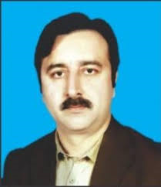
Dr. Sajid Iqbal
Department of Computer Science
Bahauddin Zakariya University, Multan

Slide 2
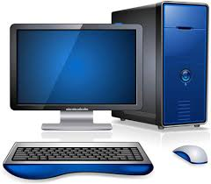
Introduction to computers
Produced By:
ComeDXD

Slide 3
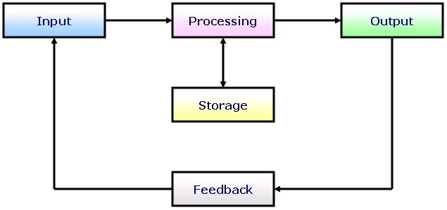
What is Computer
A computer is a machine that gets input processes them and produces the output
A computer is an electronic machine that gets input signals, transforms them from one shape to another and then produces output signals.
Computer is powerful
It can look through tons of a data
It can perform Billions of "operations" per second
Computer is stupid
Computer can not think
Each operations performed by computer is simple and mechanical
It is “you” who tells the computer what to do, you make it intelligent and useful
A computer is dumb machine made intelligent by humans

Slide 4
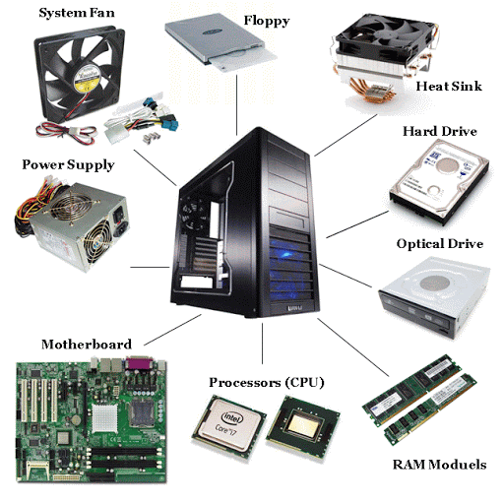
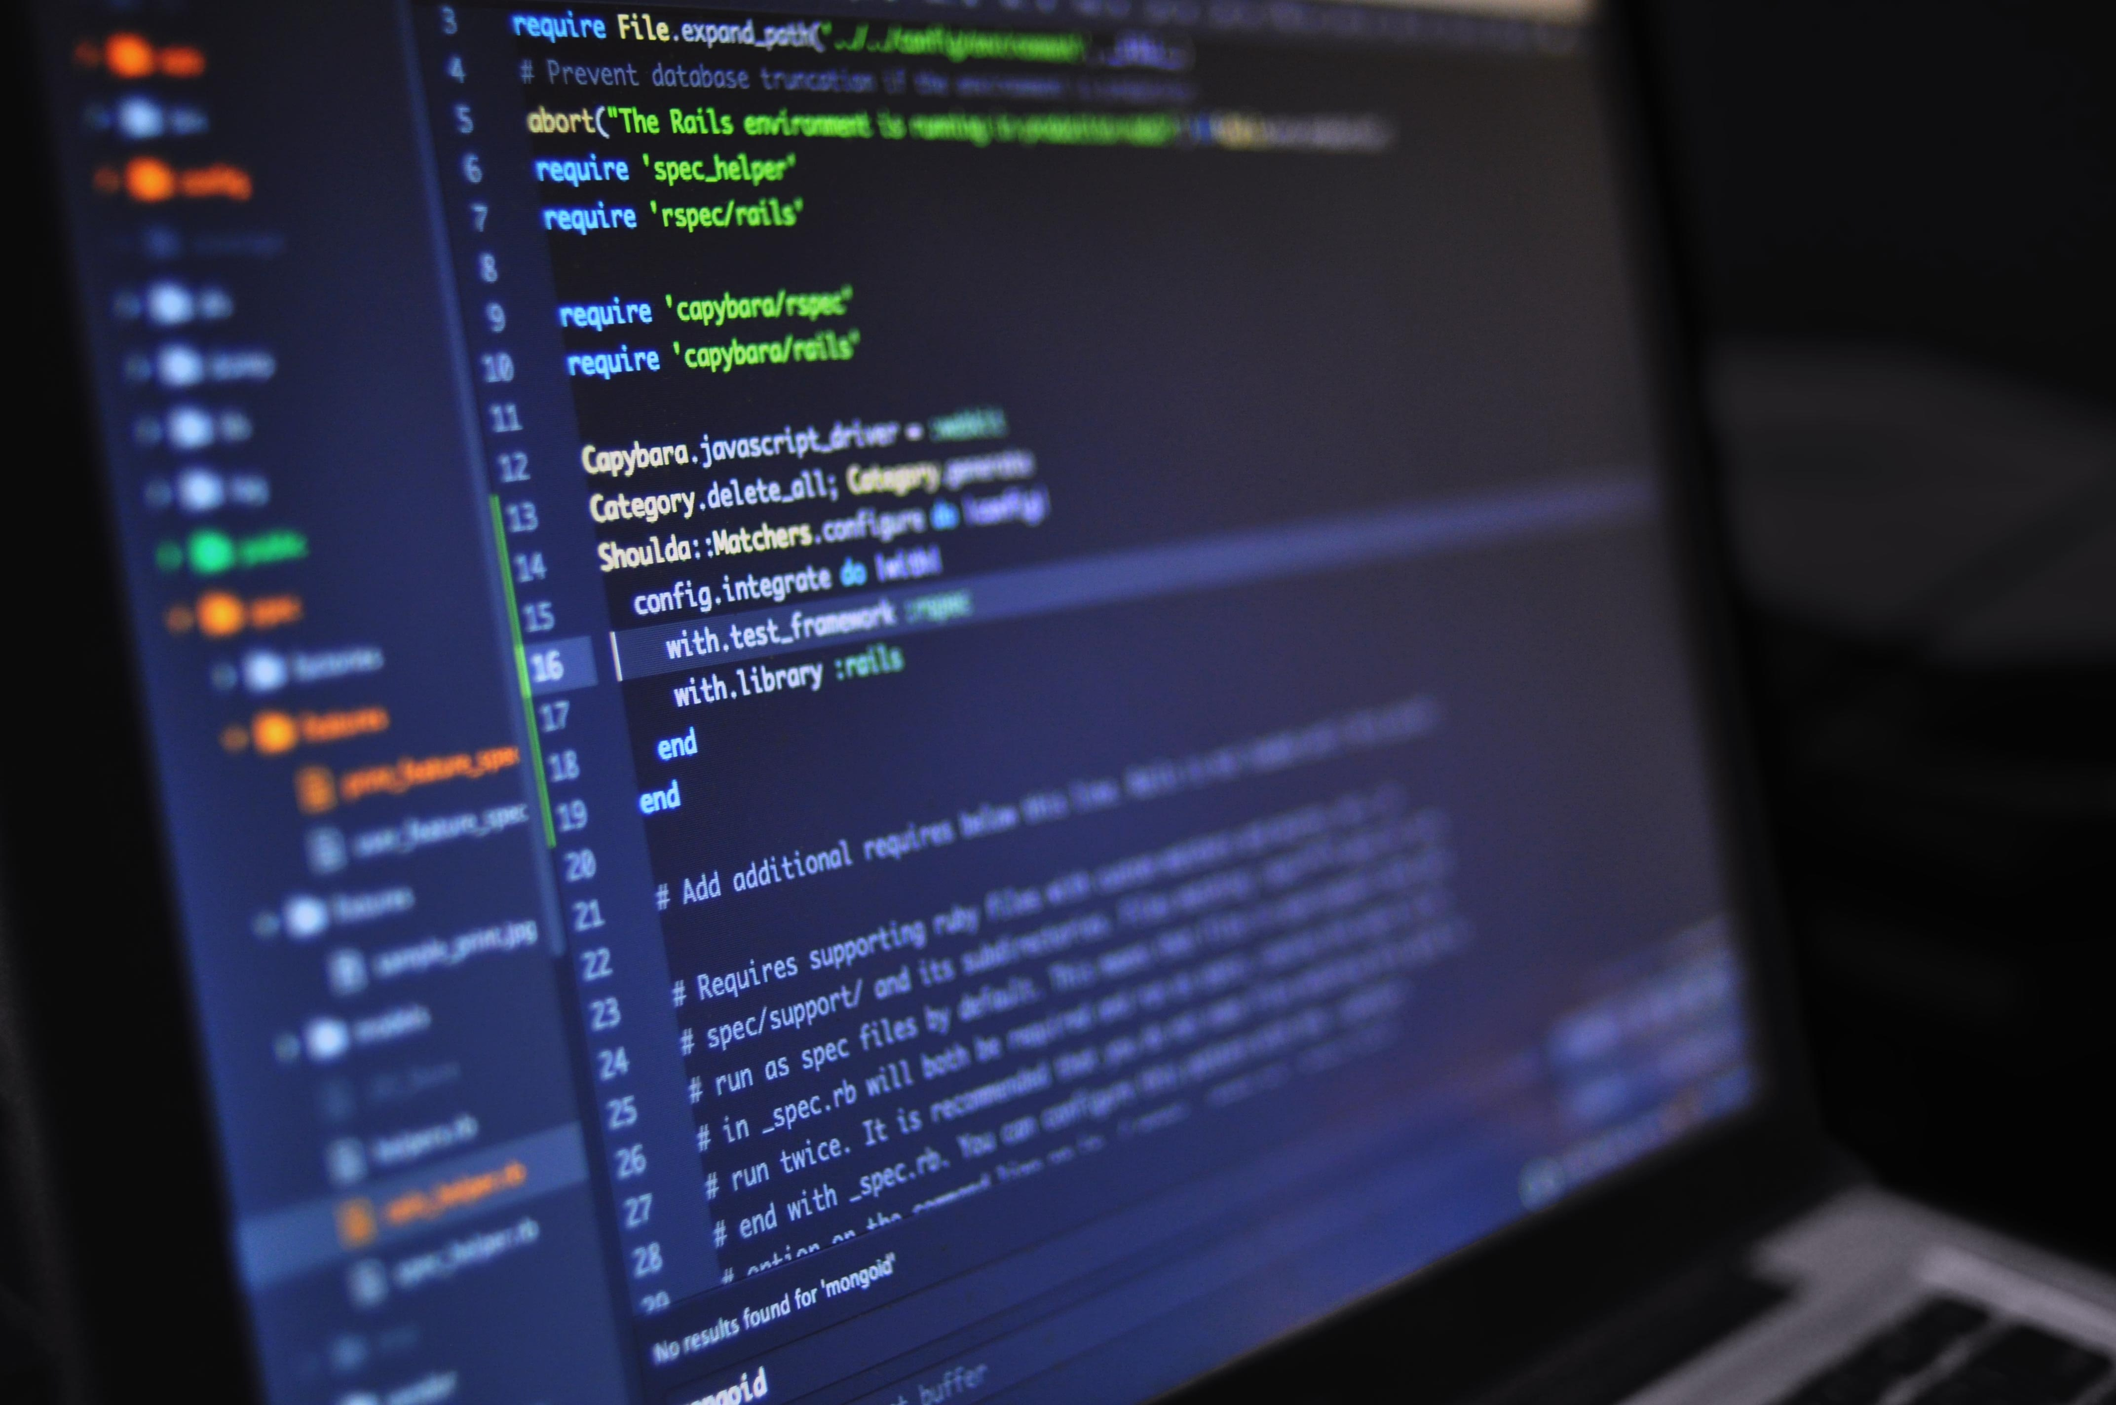

Computer Components
Hardware
Physical parts of computers that you can touch such as
The case, Central Processing Unit, Monitor, Mouse, Keyboard, Data Storage, Graphics Card, Sound Card, Speakers and Mother Board
These help in moving and transforming signals
Software
This is set of data and computer instructions that tell the hardware how to work
An instruction is a way to guide computer how to transform a signal from one form to another

Slide 5
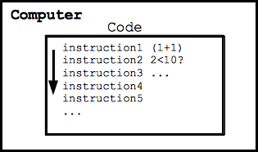
How does a computer work?
The computer follows a series of "code" instructions
Each instruction is simple (e.g. add 2 numbers)
The computer "runs" a long series of instructions
Purely mechanical
Computers are very useful
A computer is a machine that can help in big number tasks
Communication
Data Processing
Business
Medical
Entertainment
Education
Research
Commerce
Computers are hardworking but dumb
Human are intelligent but get tired

Slide 6

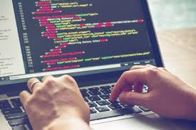
Programmers: Human Intelligence
Programmers harness the power of a computer!
The programmer thinks up a useful feature
Requires creativity, insight about human needs, and knowledge of computers
Programmers break down the steps, writing code for the computer
Dumbs it down for the computer!
Best features of both sides:
inexpensive/fast processing of computer + creative insight of the programmer
Intelligent Machine = Machine Hard work + Human Intelligence

Slide 7
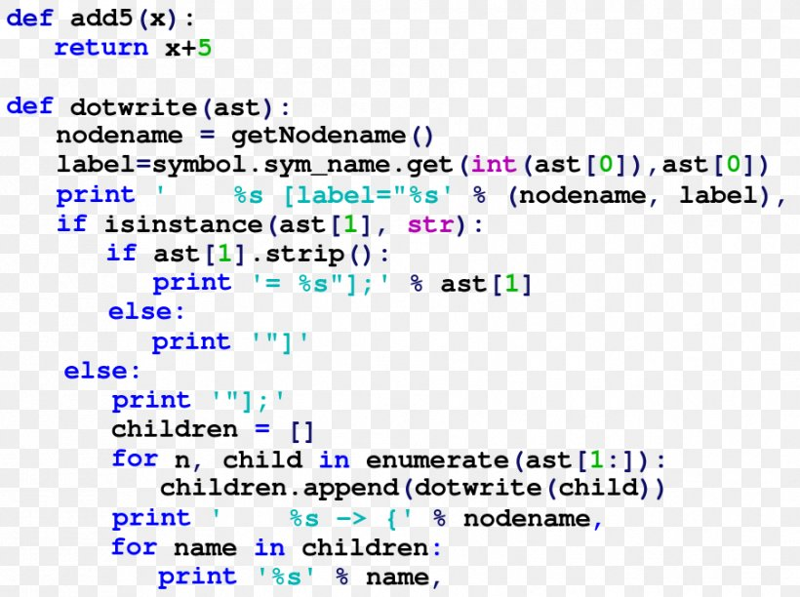
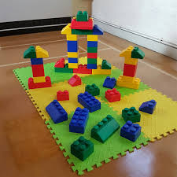
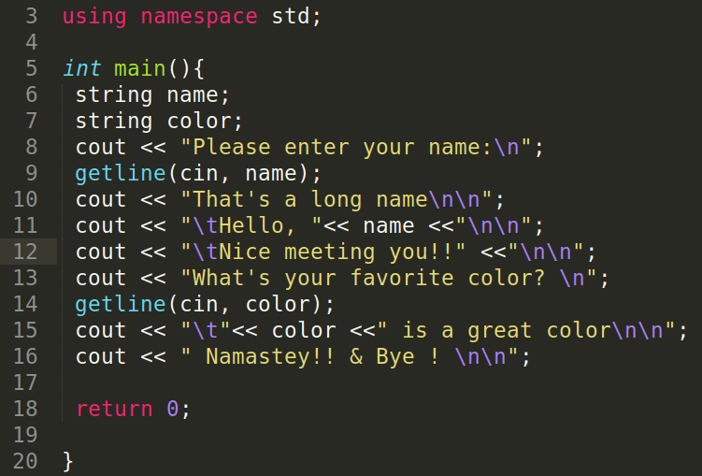
What is Code
There is a specific way to give instructions to computers
All the rules followed to give instruction to machines form the language known as computer language
There are number of set of rules to give instruction to computers
There are number of languages i.e. python, C, C++, Java
The Coding
It is like painting, it is like arranging the parts of a picture
The Lego game
We have bricks and
By arranging them differently, we can form different shapes
In programming we have different commands
By arranging them differently, we can design different programs

Slide 8
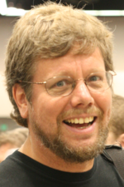
The python Language
Python is simple and easy to learn language
We will use small code segments
These code segments will not be full program or software
However big enough to show the real challenges of coding
Language Syntax
Syntax is the set of rules, principles, and processes that govern the structure of instruction i.e. printf(“hello”); OR print(‘hello’)
Language Semantics
It deals with the meaning of syntactically correct instruction
Guido van Rossum
Founder of Python
#include <stdio.h> int main()
{
printf( "Hello, World!" );
}
print("Hello, World!”)
X++;
C vs Python Syntax
For same task
X=X+1;
Semantics of 2 statements
For same task

Slide 9
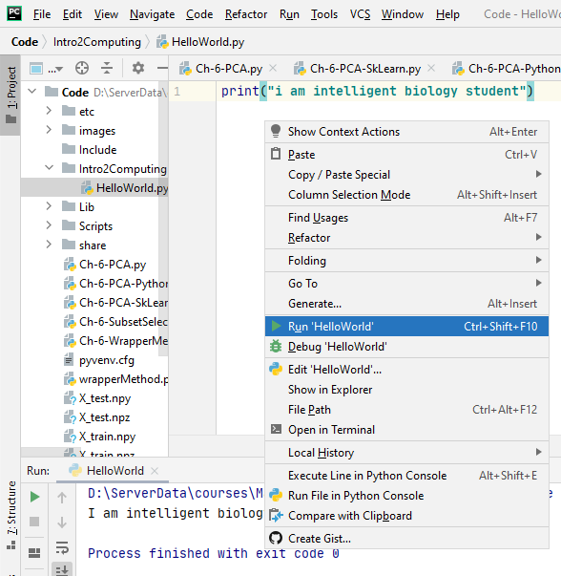
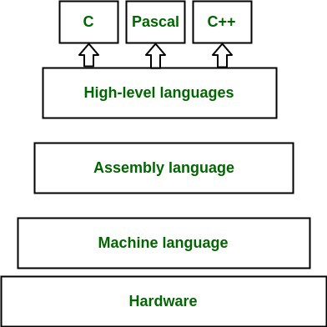
First Python Program
You write program in a way that you can understand
Computer first converts it in the form that it can understand
Compilation: arranging the instruction in computer understandable way
Machine translation: It converts it to the form that it can understand and work according to that
Compiler
The software that arranges the instructions
Interpreter
The software that interprets instructions one by one

Slide 10
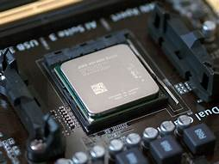
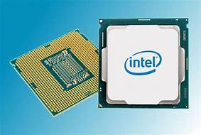

Running Programs
What is meant by ‘program run’ and how CPU does this
You write instructions in English like language
The CPU implements "machine code" instructions
Each machine code instruction is extremely simple
Add 2 numbers $(x+y)$
Compare 2 numbers $(x<y)$
In python we have used:
Python is not machine code. It is high level language
Python does not run on CPU directly
Python works in translation
A simple statement like is translated to multiple machine language statements
print("hello python")
2+2

Slide 11
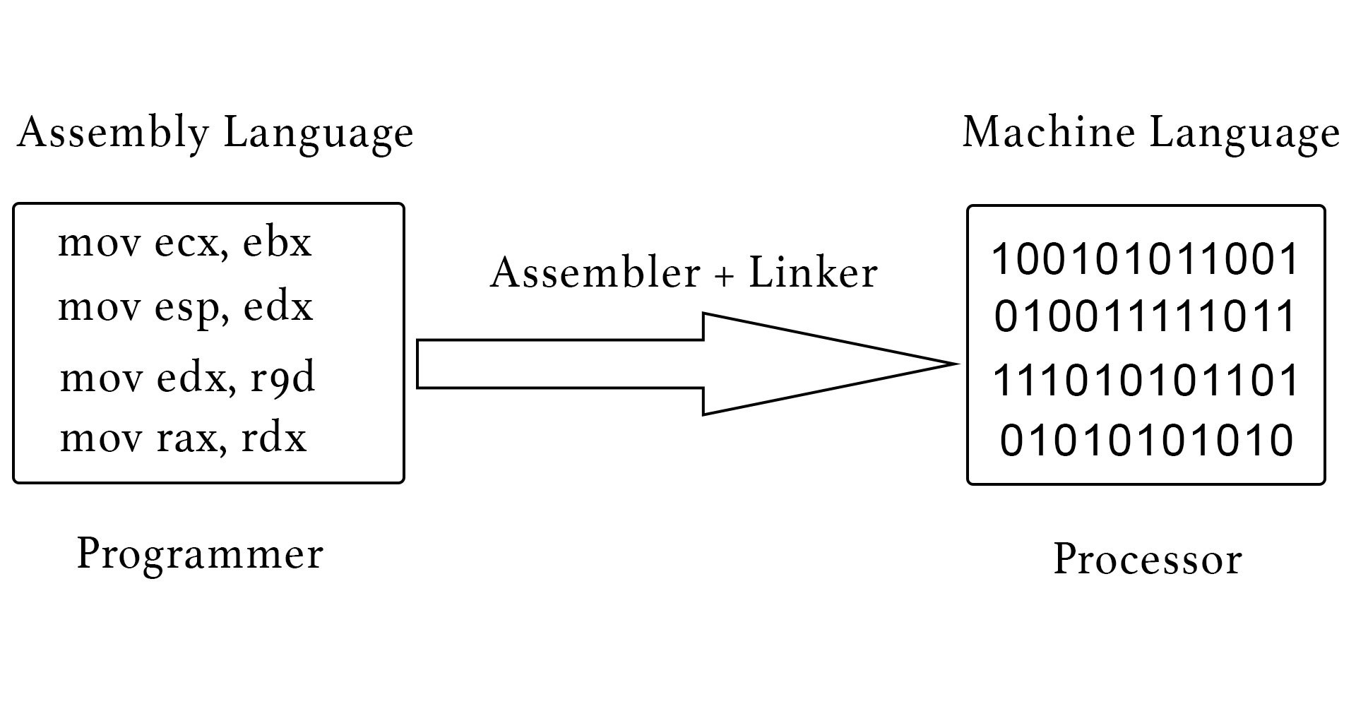

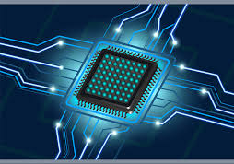
The Program Translation Pipeline
A program is written in high level language i.e. Python
It is English like instructions
The High level language program is translated to Assembly language
Finally the Assembly language program is converted to machine language program
Machine code is hardwired into the design of the CPU hardware
It can be changed by programmer
Each family of compatible CPUs has its own machine language
One machine code can not be run on other type of processor i.e. intel and IBM
print("hello python")

Slide 12
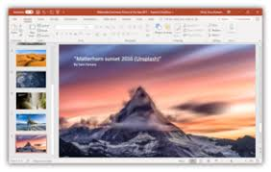
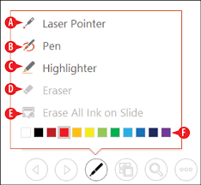
What is program or APP?
A software is made up of millions of instructions like power point
There are sets of instructions that performs different functionalities of the software. For example
Presentation starts (one set of instructions)
Cursor moves (other set of instructions)
Annotation on slides is done (another set of instructions)
A software is either in the form of single file or set of files present in computer storage

Slide 13
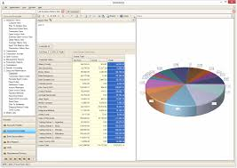
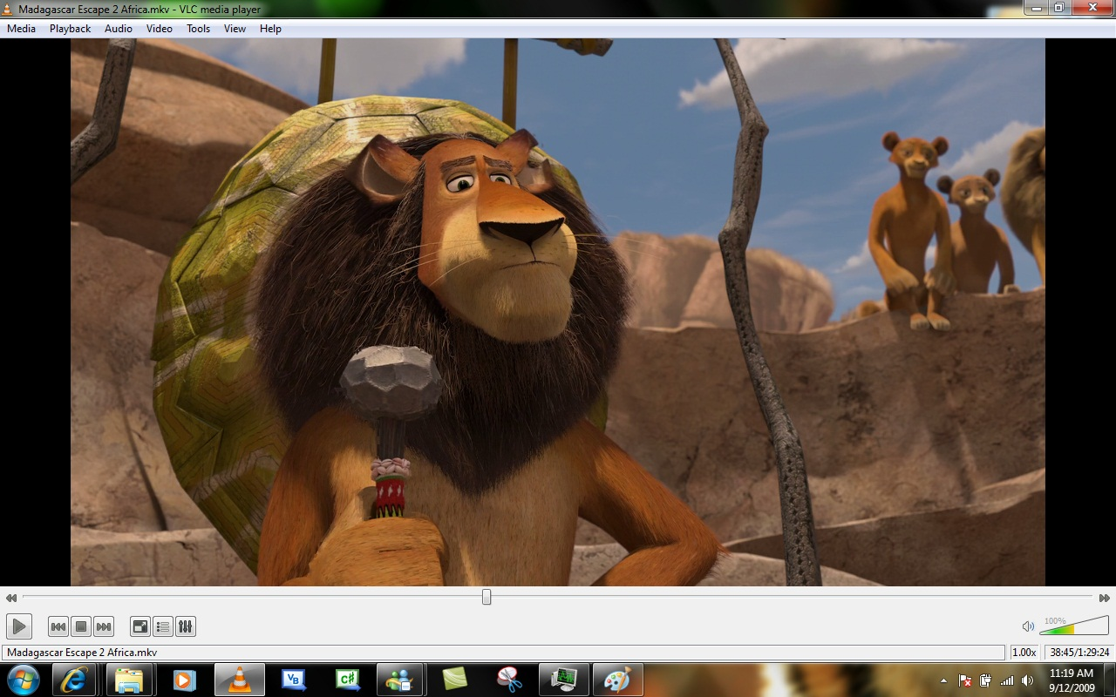
Types of Software/Program
Application Software
A program or group of programs designed for end users
Examples: Accounting application, web browser, email client, media player, file viewer, simulators, games or a photo editor.
Biology simulation software can help you understand the content that you study. One such site is: https://www.biologysimulations.com/
System Software
This provides platform for other software to work i.e. Operating System
Operating System performs resource management
Set of supervisory programs that manage the computer
The operating system runs when the computer first starts up
Manage the start/stop of programs
Manage RAM
Manage persistent storage
Computers can run multiple programs at the same time
Operating system keeps track of the information for each program and shares resources (like RAM) among the programs
Operating Systems
Microsoft Windows
Android
Linux …

Slide 14
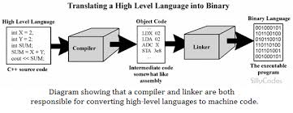
Source Code vs Machine Code
Source Code
The program written by a human being in high level programming language
It does not run directly on computer
Machine Code
CPU understands it
The translation from source code to machine code can be done
Ahead of time using compilation
In real time using interpretation
It is hard for human being to understand the machine code

Slide 15
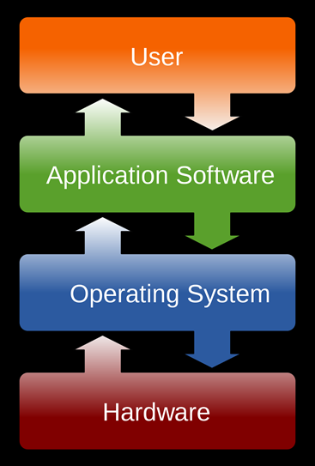
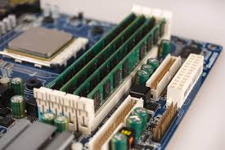
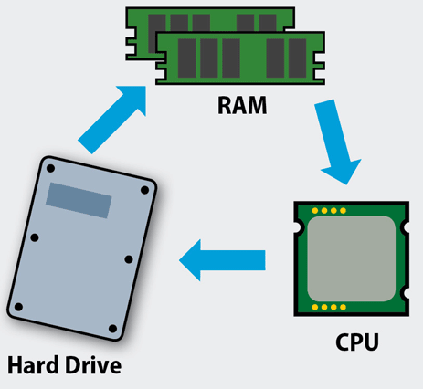
How does a program run?
General Software run process
A program is written (let assume) in the form of single file and stored in hard-disk (on hardware)
User requests to start application software
The application software communicates with operating system
The operating system access the hardware and fetches the software file in RAM
Each program gets its own area in RAM
Execution process
CPU reads one instruction at a time from RAM
Executes the instruction i.e. performs what instruction says
Stores the produced results (if any) back to RAM
Fetches the next instruction
The program is running now

Slide 16



Proprietary Software
Proprietary Software
The software owned by some one i.e. Microsoft Word
Microsoft owns and controls the source code
Microsoft sells you Word software and permission to run it
You just have the machine code!
Word has lots of valuable features, and you pay Microsoft for the right to use it
Control: Microsoft has all the control, customer can just buy or not
There are many other companies that produce proprietary software like
Google, IBM, Facebook, …

Slide 17
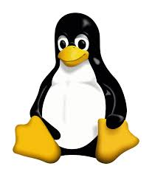



Open Source Software
Open Source Software is incredibly widespread
Computers, phones, the internet .. built with tons of open source software
Open source software is free; no vendor is paid
Examples of open source software:
Linux operating system
The Android operating system (95% of it)
Parts of Mac OS X (50%?)
The Chrome Browser (!!!)
The Firefox Browser
The MySQL database system
The GCC compiler
Computer languages: C, C++, Python, Java, Javascript
Any computer/phone/site you use, there's lots of open-source software in the "stack"

Slide 18



Thanks for watching
Dr. Sajid Iqbal
Assistant Professor
Department of Computer Science
Bahauddin Zakariya University, Multan
sajidiqbal.pk@gmail.com
https://github.com/sajjo79/Introduction-to-Computers
Allah Hafiz
COMEDXD

